Slide 1

Screening of Urine Bioassay Samples using a Standard Nuclear Medicine Gamma Camera
Chris Martel
Director, RSO
Brigham & Women’s Hospital
Associate in Radiology
Harvard Medical School
Rakesh Kannan, RT(N)
Dept. of Nuclear Medicine
Brigham & Women’s Hospital

Slide 2
Triage Decisions
Diagnose
Treat
Screen

Slide 3
Research Question
If a radiological incident occurred involving the contamination of large numbers of the public, can the gamma camera be used effectively to screen urine bioassay samples to identify those samples that need to be sent to a lab for further analysis?
What can we measure? / What would we miss?

Slide 4
Materials
Siemens Symbia SPECT/CT
  Dual head gamma camera
  High energy collimator
  Plastic drinking water cups (16 oz.)
  Cardboard tray with absorbent pad
  Capintec CRC-25R Dose Calibrator
  F-18 (FDG) Positron emitter – 511 keV annihilation radiation photons

Slide 5
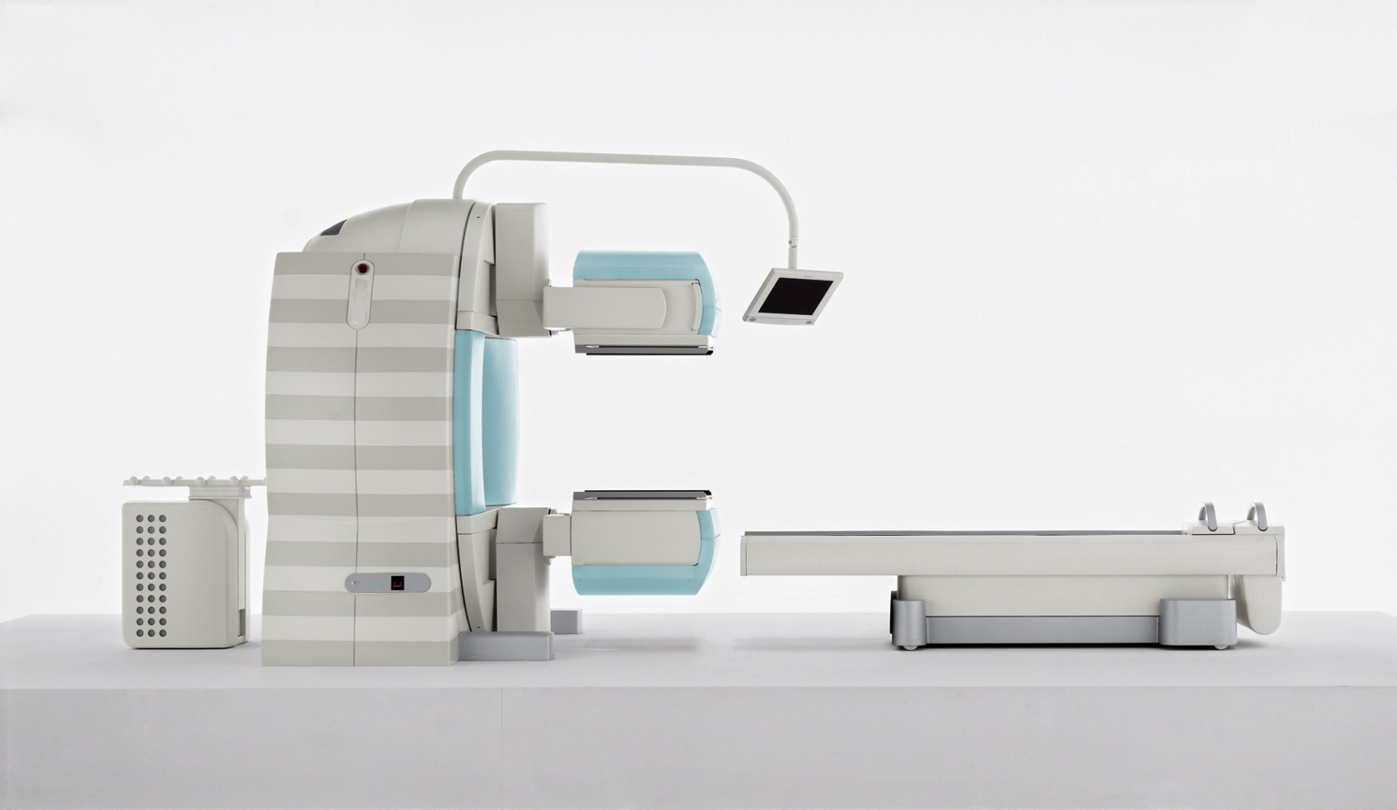
Siemens Symbia SPECT/CT

Slide 6
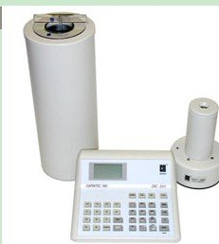
Capintec Dose Calibrator

Slide 7
Methods
Cups were filled with about 250 ml of water
Aliquots of F-18 (as measured by dose calibrator) added to cups of water.
Cups placed in cardboard box/absorbent
Box placed on gamma camera head
Standard lung counting protocol selected with F-18 window at 30%. (50% window also available)

Slide 8
Methods
Technologist told to identify the “hot” samples.
Samples and background counted for 3 minutes.

Slide 9
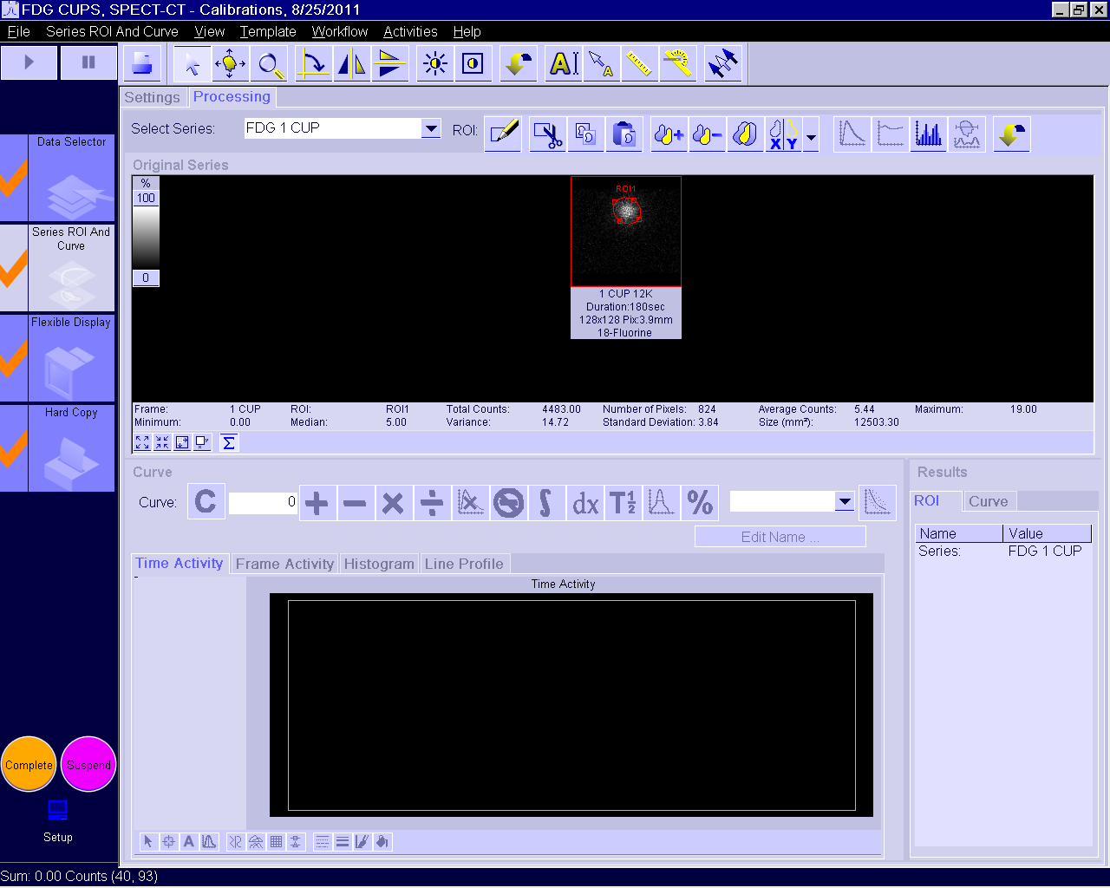
Here is what he saw

Slide 10
One hot sample among non rad samples

Slide 11
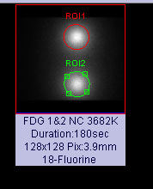
Two hot cups in box others in between
Samples were
9-inches apart
with a non rad
sample between
No collimator

Slide 12
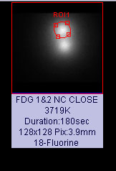
Two samples close together (Touching) with no collimator
How one draws a region
of interest will impact
quantitative analysis.
Use data to quantify
with caution!
Suggest using counts
per pixel.

Slide 13
Results
Sample | Activity (dpm) | With collimator – Size corrected (cpm) | No Collimator – Size Corrected Decay Corrected (cpm)
0 | 0 | 79 | 403
1 | 8.9E6 | 4132 | 383275
2 | 1.1E7 | 4474 | 365428
3 | 8.9E6 | 4253 | -
4 | 1.1E7 | 4582 | -
5 | 6.7E6 | 2975 | -
Efficiency with collimator – 0.01%
Efficiency without collimator – 2.2%

Slide 14
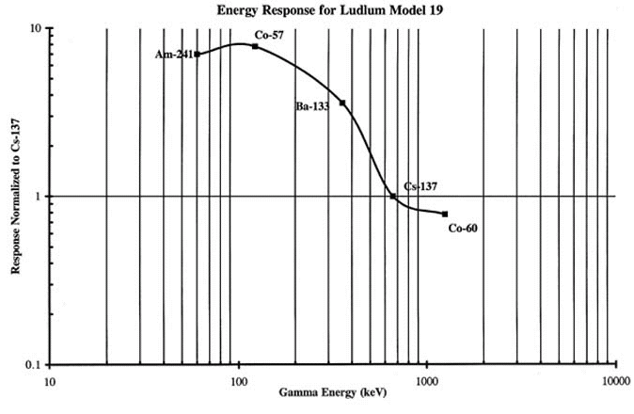
NaI Response relative to Cs-137

Slide 15
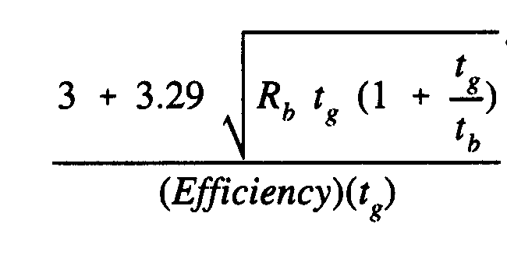

MDC for Cs-137 in about
250 ml of Urine

Slide 16
IRF-Ingestion
IRF-Inhlation

Slide 18
What can we measure?
One can measure 1/10th of an ALI (ingestion or inhalation) for ¹³⁷Cs beyond 60 days after the event.
For lower energy photon emitters, the attenuation in the sample will be compensated to a degree by the increase in detection efficiency.

Slide 19
What would we miss?
Non (or very low yield) photon emitters
  Po-210
  H-3
  C-14
High energy beta emitters (e.g., Sr/Y-90) may be detectable through brehmstrahlung.

Slide 20
Conclusions
Gamma camera can be used without the collimator to visually screen urine bioassay samples.
Sensitivity appears to be sufficient to make adequate decisions in line with CDGs.
Throughput – 25 samples in total 10 minutes for 150 per hour and 1,200 per 8 hour shift.
  Can be increased using scan along bed.

Slide 21
Scanning

Slide 22
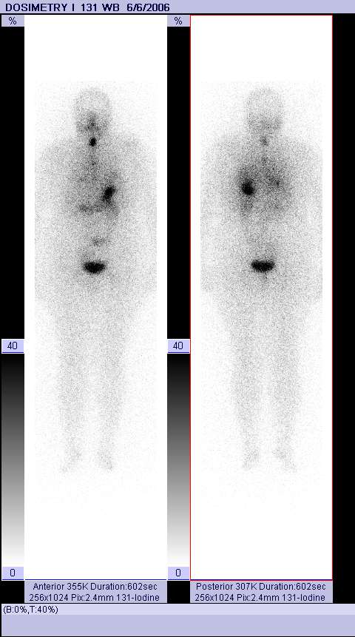
Conclusions
Recommend more robust study on capabilities of gamma camera for screening urine samples.
  Different radionuclides
  Use camera to scan samples.

